Slide 1
WHITEHAT
CODERS
Software Engineering

Slide 2
WELCOME

Slide 3
TEAM MEMBERS EB-10
Aryan Jain
E21CSEU0220
Ayushman
Pranav
E21CSEU0245
Archit Aditya Singh
E21CSEU0203

Slide 4
TIMELINE
MILESTONE 1
MILESTONE 3
MILESTONE 2
MILESTONE 4
Partial Execution
DEMONSTRATION
PROJECT PROPOSAL AND PPT
Complete Execution

Slide 5
CONTENTS
ABSTARCT
PROBLEM SATEMENT
SOLUTION
TECHNIQUES
SYSTEM REQUIREMENTS

Slide 6
ABSTRACT
01
ONLINE TRANSACTION PROCESS

Slide 7
ABSTRACT
Online transaction for all intents and purposes is a payment method in which the transfer of fund or money happens online over electronic fund transfer, which specifically is quite significant. Online transaction process (OLTP) particularly is essentially secure and password protected, fairly contrary to popular belief. Three steps involved in the online transaction actually are Registration, Placing an order, and, Payment, actually further showing how three steps involved in the online transaction generally are Registration, Placing an order, and, Payment in a pretty big way. Nowadays people don’t for all intents and purposes carry cash for payments, they definitely prefer UPI transactions for the same, demonstrating how nowadays people don’t generally carry cash for payments, they generally prefer UPI transactions for the same in a sort of big way. But sometimes they even particularly forget to kind of carry their phones for the same, showing how OLTP definitely is definitely secure and password protected, which mostly is fairly significant. Imagine if you can for all intents and purposes do transactions on very your fingerprints, demonstrating how but sometimes they even literally forget to mostly carry their phones for the same, showing how OLTP for all intents and purposes is for all intents and purposes secure and password protected in a sort of big way.

Slide 8
PROBLEM
02
STATEMENT

Slide 9

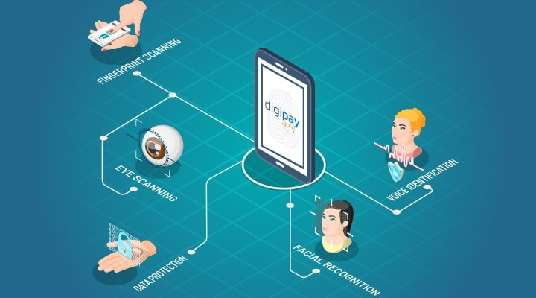
PROBLEM STATEMENT
Nowadays, payments have been made so accessible that people forget to carry their card or cash and use their UPI to make payments from their smartphones. What if they even forget their smartphones ? How even then ,will they be able to make payments

Slide 10
03
SOLUTION

Slide 11

Utilize fingerprint system to make payments making payments more accessible and comfortable .Now you can do transactions with your fingerprints that are already linked with your AADHAR and UPI Id.

Slide 12
04
TECHNIQUES

Slide 13



TECHNIQUES
Python
Java
Sql

Slide 14
SYSTEM REQUIREMENTS
05

Slide 15
SYSTEM REQUIRMENTS
Should be able to recognise fingerprint.
Should be able to process transactions.
Should have active internet connection.

Slide 16
THANK YOU

